Slide 1
APPLICATION LAYER
Chapter 6
Mrs.Archana Varade
MIT-WPU
Pune

Slide 2
DOMAIN NAME SYSTEM
DNS translates domain names to IP addresses so browsers can load Internet resources.
Each device connected to the Internet has a unique IP address which other machines use to find the device.
DNS servers eliminate the need for humans to memorize IP addresses such as 192.168.45.23

Slide 3
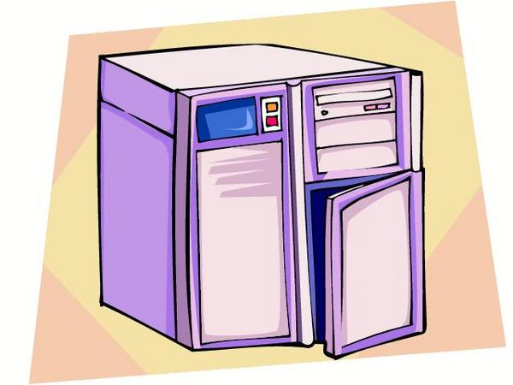
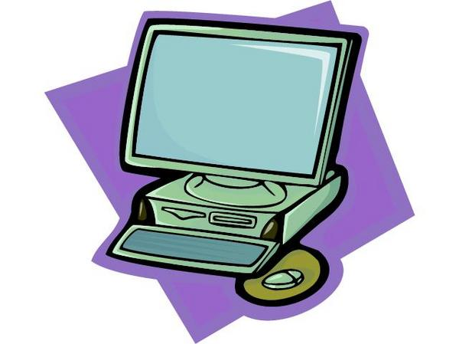
Introduction
1. What is the IP address of udel.edu ?
It is 128.175.13.92
1. What is the host name of 128.175.13.74
It is strauss.udel.edu

Slide 4
DOMAIN NAME SYSTEM
The Domain Name System (DNS) is a hierarchical and decentralized naming system for computers, services, or other resources connected to the Internet or a private network.
It associates various information with domain names assigned to each of the participating entities.
It translates more readily memorized domain names to the numerical IP addresses needed for locating and identifying computer services and devices with the underlying network protocols.

Slide 5
DNS COMPONENTS
There are 3 components:
Name Space:
Specifications for a structured unique names and data associated with the names
Resolvers:
Client programs that extract information from Name Servers.
Name Servers:
Server programs which hold information about the structure and the names.

Slide 6
Domain Name Space
Flat Name Space
A name in this space is a sequence of characters without structure.
Network Information System (NIS),a central site looked after administration of name space.
The main disadvantage of a flat name space is that it cannot be used in a large system such as the Internet because it must be centrally controlled to avoid ambiguity and duplication.

Slide 7
Domain Name Space
Hierarchical Name Space
In a hierarchical name space, each name is made of several parts. The first part can define the nature of the organization, the second part can define the name of an organization, the third part can define departments in the organization, and so on.
In this case, the authority to assign and control the name spaces can be decentralized.
A central authority can assign the part of the name that defines the nature of the organization and the name of the organization. The responsibility of the rest of the name can be given to the organization itself.

Slide 8
Domain Name Space
The mechanism that implements hierarchical name space is called Domain Name Space.
In this design the names are defined in an inverted-tree structure with the root at the top. The tree can have only 128 levels: level 0 (root) to level 127.
Topics discussed in this section:
Label
Domain Name
Domain

Slide 9
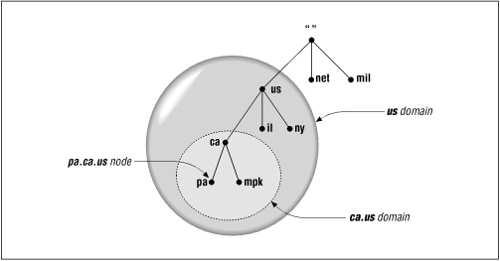
Domain

Slide 10

Domain names and labels
Label should have max. 63 characters

Slide 11
DISTRIBUTION OF NAME SPACE
The information contained in the domain name space must be stored. However, it is very inefficient and also unreliable to have just one computer store such a huge amount of information. In this section, we discuss the distribution of the domain name space.
Topics discussed in this section:
Hierarchy of Name Servers
Zone
Root Server
Primary and Secondary Servers

Slide 12

Hierarchy of name servers

Slide 13

Zones and domains

Slide 14
DNS IN THE INTERNET
DNS is a protocol that can be used in different platforms. In the Internet, the domain name space (tree) is divided into three different sections: generic domains, country domains, and the inverse domain.
Topics discussed in this section:
Generic Domains
Country Domains
Inverse Domain

Slide 15

DNS IN THE INTERNET

Slide 16

Generic domain labels

Slide 17
RESOLUTION
Mapping a name to an address or an address to a name is called name-address resolution.
Topics discussed in this section:
Resolver
Mapping Names to Addresses
Mapping Addresses to Names
Recursive Resolution
Iterative Resolution
Caching

Slide 18
DNS RESOLVERS
A Resolver maps a name to an address and vice versa.
Query
Response
Resolver
Name Server

Slide 19
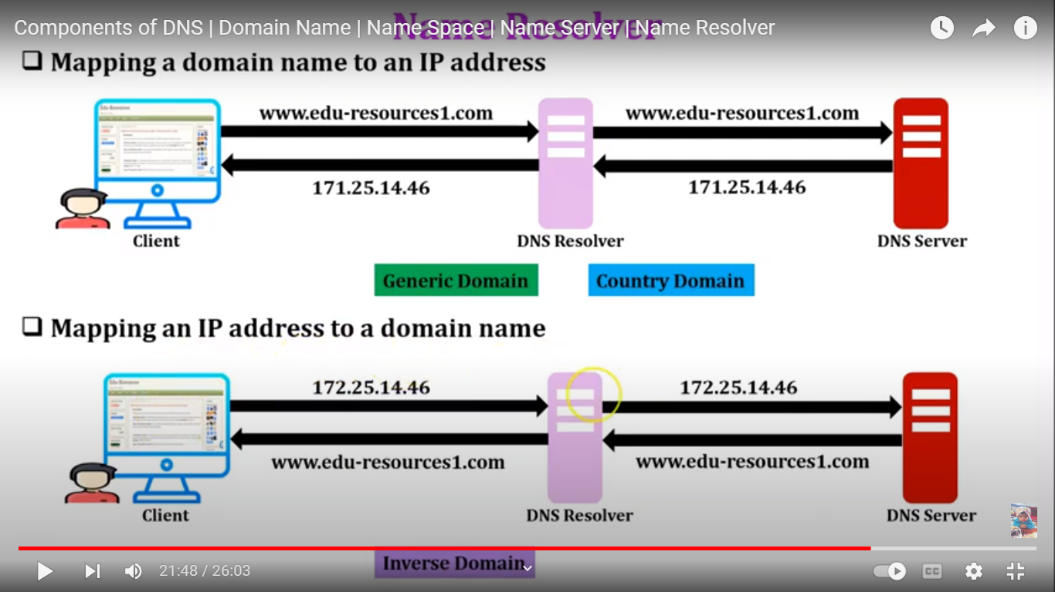

Slide 20

Recursive resolution

Slide 21

Iterative resolution

Slide 22
World Wide Web
The WWW today is a distributed client/server service, in which a client using a browser can access a service using a server. However, the service provided is distributed over many locations called sites.
Topics discussed in this section:
Client (Browser)
Server
Uniform Resource Locator

Slide 23

Architecture of WWW

Slide 24
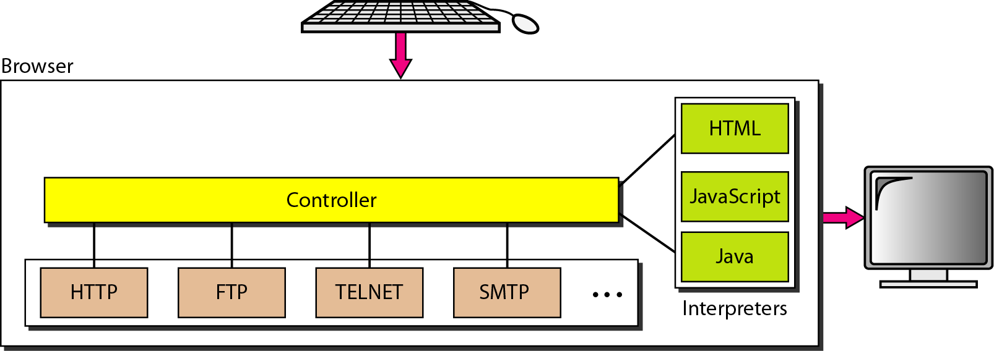
Client Browser

Slide 25
WEB DOCUMENTS
The documents in the WWW can be grouped into three broad categories: static, dynamic, and active. The category is based on the time at which the contents of the document are determined.
Topics discussed in this section:
Static Documents
Dynamic Documents
Active Documents

Slide 26

What is Electronic Mail?
Electronic mail (email) is a method of exchanging messages between people using computers. It's one of the most widely used services on the internet, allowing instant communication across the globe.
Unlike traditional mail, email messages travel through networks at incredible speeds, reaching recipients in seconds rather than days.
Instant Delivery
Global Reach
Cost Effective
Messages arrive in seconds, not days
Connect with anyone worldwide
Free or minimal cost to send

Slide 27
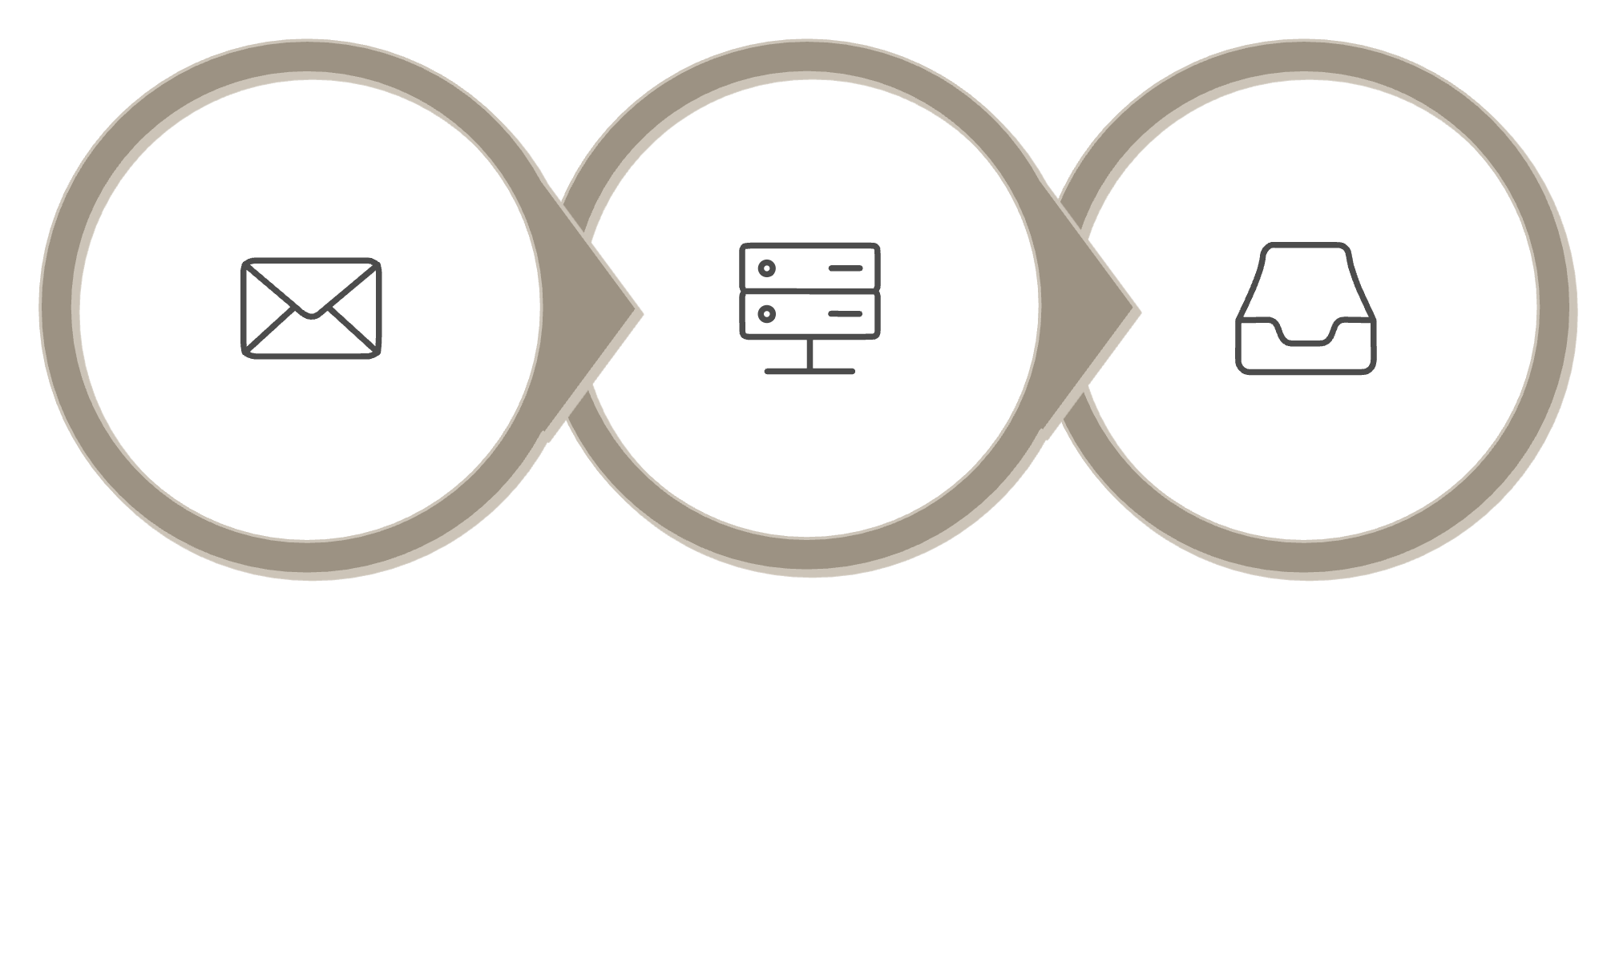



How Email Works: The Basic Process
User Sends
Server Routes
Recipient Inbox

Slide 28



Mail Servers: The Backbone of Email
Mail Server
SMTP Server
IMAP/POP3 Server
A computer that sends, receives, and stores email messages. Think of it as a digital post office that handles your messages.
Sends outgoing mail using Simple Mail Transfer Protocol. It's responsible for delivering your messages to their destination.
Receives and stores incoming mail. IMAP keeps messages on the server, while POP3 downloads them to your device.

Slide 29
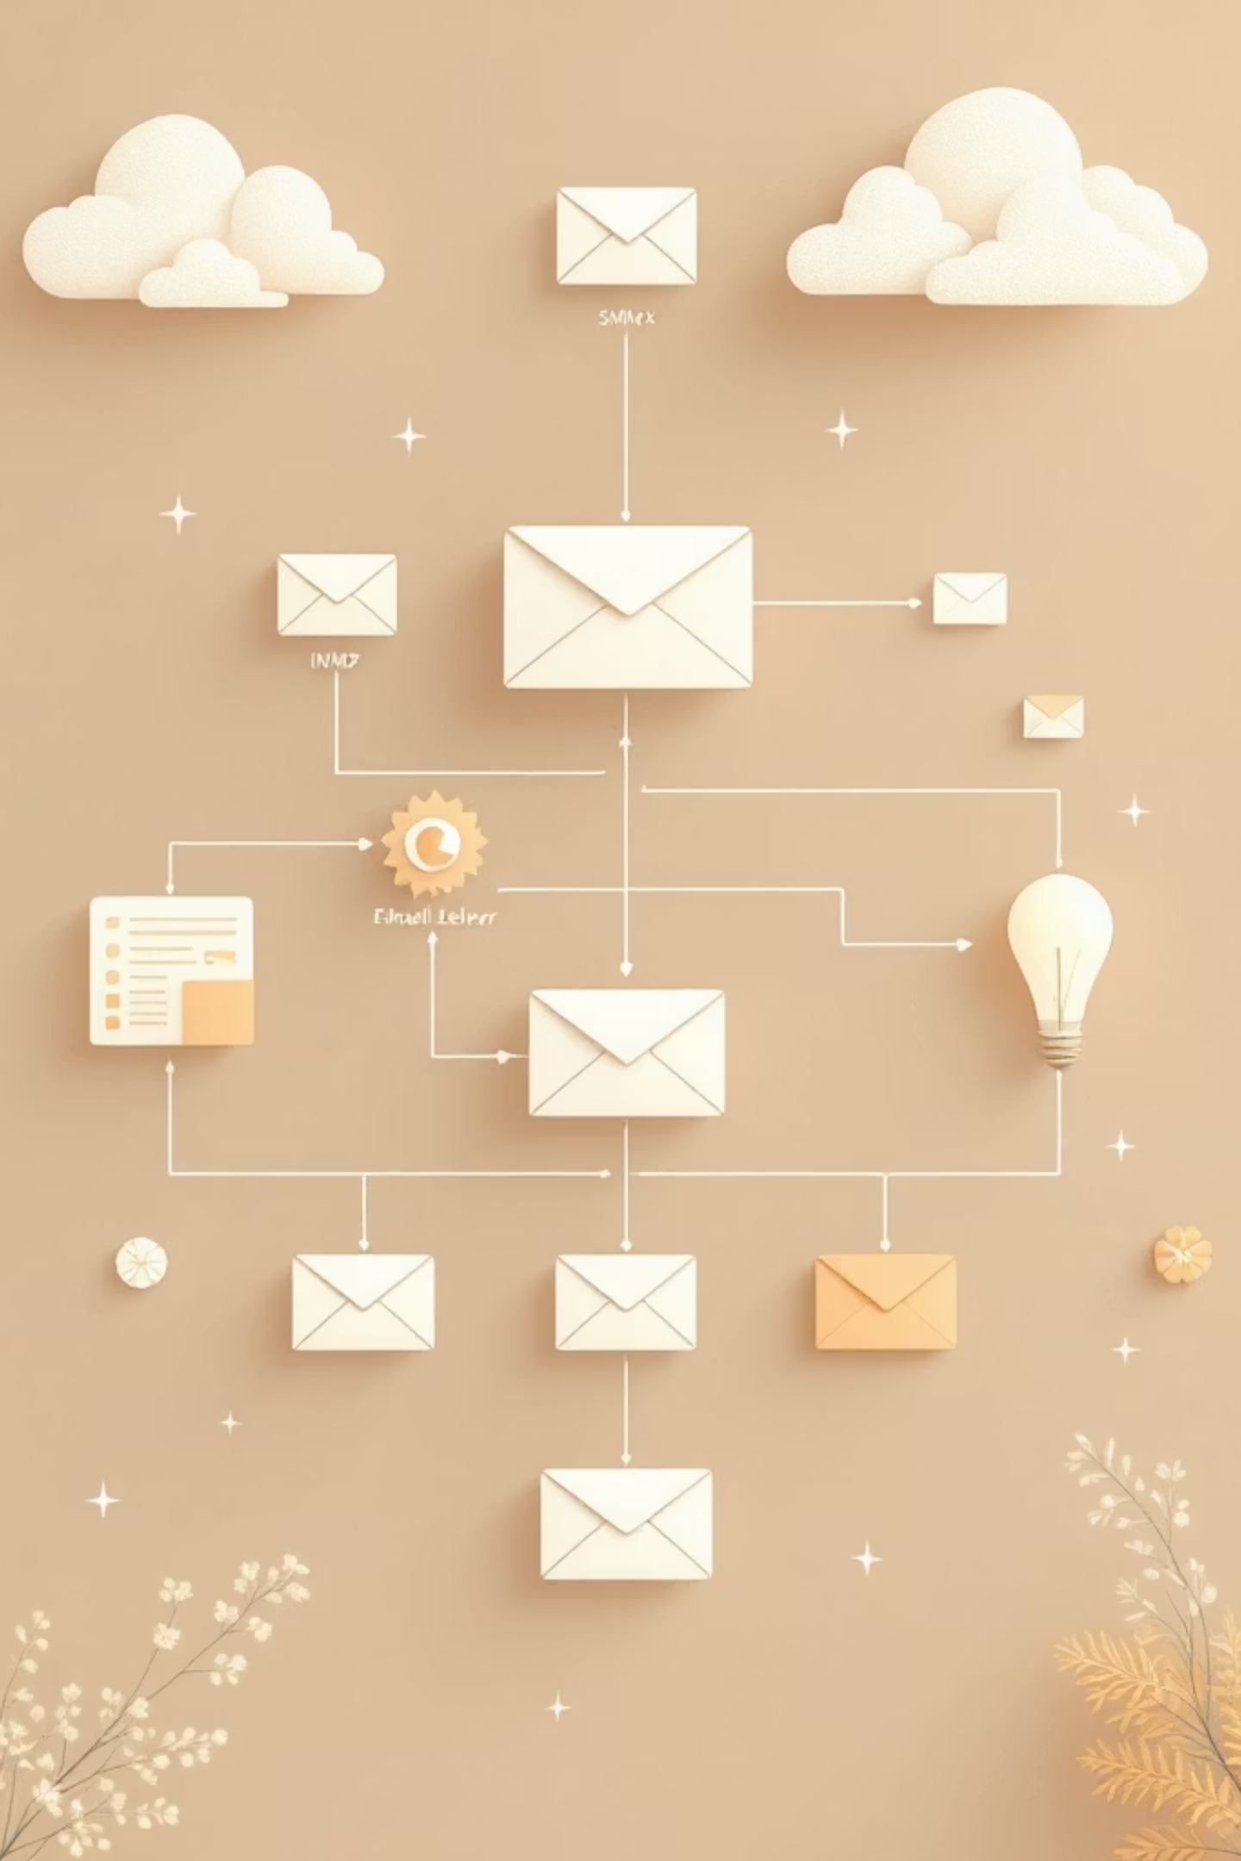
Key Email Components
Email Client
1
Software you use to write and read emails (Outlook, Gmail, Apple Mail)
2
Mail User Agent (MUA)
The interface that lets you compose, send, and read messages
3
Mail Transfer Agent (MTA)
Server software that routes and transfers messages between servers
4
Mail Delivery Agent (MDA)
Places incoming messages into the recipient's mailbox

Slide 30
Essential Email Protocols
SMTP
POP3
Simple Mail Transfer Protocol
Post Office Protocol
Used for sending emails from your client to the mail server and between servers. Port 25 or 587 for secure connections.
Downloads messages from server to your device. Messages are deleted from server after download. Port 110.
IMAP
MIME
Internet Message Access Protocol
Mail Extension Protocol
Keeps messages on server, allowing access from multiple devices. Synchronizes changes across all devices. Port 143.
Encodes attachments and non-text content for transmission. Enables sending images, documents, and files.

Slide 31

The Complete Email Journey
Compose
SMTP Send
Store
Deliver & Read

Slide 32






Advantages of Email Systems
Speed
Cost-Effective
Messages delivered instantly across any distance
Minimal cost compared to traditional mail
Global Access
Attachments
Send messages anywhere in the world
Include files, images, and documents
Organization
Accessibility
Sort, search, and archive messages easily
Access from computers, tablets, and phones

Slide 33

Security Issues in Email Systems
Phishing Attacks
Fraudulent emails designed to steal passwords and financial information. Always verify sender addresses before clicking links.
Malware & Viruses
Malicious software attached to emails can infect your computer. Never open attachments from unknown senders.
Spam Messages
Unsolicited bulk emails that clutter inboxes. Use spam filters and don't share your email publicly.
Data Interception
Messages can be intercepted during transmission. Use encrypted connections (SSL/TLS) and avoid sending sensitive data via email.

Slide 34
Key Takeaways
01
02
Email uses servers and protocols
Multiple components work together
SMTP for sending, IMAP/POP3 for receiving messages
Clients, servers, and agents collaborate to deliver messages
03
04
Fast and cost-effective communication
Security is essential
Instant global reach with minimal cost
Protect against phishing, malware, and data interception

Slide 35
Audio streaming
Audio streaming is the continuous transmission of audio data (like music or podcasts) from a server to a client device over the internet. It allows users to listen to media in real time without needing to download files completely to their device storage.
Types of Audio Streaming
On-Demand: Pre-recorded content that users can listen to at any time (e.g., Spotify, Apple Podcasts).
Live: Broadcasting real-time audio over the internet as it is being created (e.g., Internet radio, live concert broadcasts).
Real-Time Interactive: Two-way or multi-way audio communication streams (e.g., VoIP calls, online conferencing).

Slide 36
Audio streaming
Streaming Media Formats
Audio formats refer to the combination of the codec (algorithm compressing/decompressing the data) and the container (the file wrapper holding it).
AAC (Advanced Audio Coding): The default format for most modern streaming services (like Apple Music and YouTube). Offers high fidelity at lower bitrates.
MP3: Highly popular, legacy lossy format. It is universally compatible but removes less noticeable audio frequencies to save bandwidth.
OGG Vorbis: A free, open-source lossy format frequently used by platforms like Spotify.
FLAC (Free Lossless Audio Codec): An audiophile-grade format that compresses audio without losing any original quality, though it requires higher bandwidth.

Slide 37
Audio streaming
Streaming Protocols
Protocols are the underlying network rules dictating how audio data is transmitted, broken into packets, and played back.
HLS (HTTP Live Streaming): Developed by Apple, it segments audio files into small chunks delivered via standard HTTP. It is highly reliable and handles network fluctuations well.
WebRTC: A modern, open-source protocol built for ultra-low latency, peer-to-peer audio communication in web browsers.
RTSP & RTP (Real-Time Streaming Protocol/Real-Time Transport Protocol): Classic protocols used for controlling and transporting real-time audio and video.
Icecast & Shoutcast: Dedicated networking tools specifically designed for broadcasting internet radio stations.

Slide 38
Audio streaming
Different Applications
Music Platforms: Spotify, YouTube Music, Amazon Music.
Podcasts: Apple Podcasts, Google Podcasts.
Communication & Conferencing: Zoom, Microsoft Teams, Discord.
Live Broadcasting: Internet radio stations, Twitch (for live audio/voice channels).

Slide 39
Audio streaming
Advantages
Zero Wait Time: Playback begins almost instantly rather than waiting for massive file downloads.
Saves Device Storage: Requires little to no local memory to store libraries, as data is temporarily cached and cleared via buffering.
Convenience & Accessibility: Provides users instant access to millions of songs and podcasts from any internet-connected device.
Live Capabilities: Enables real-time listening experiences across global audiences.
Disadvantages
Internet Dependency: Offline playback is limited, and buffering/stuttering can occur during poor network conditions.
Data Usage: Constant streaming consumes mobile or broadband data caps.
Audio Compression: Lossy compression formats can slightly reduce audio fidelity compared to uncompressed physical files.

Slide 40
Video streaming
Streaming Media Formats
When video and audio data are processed, they must be compressed and formatted. This relies on two core elements:
Codecs: Algorithms that compress raw media files to save bandwidth without sacrificing significant quality (common examples include \(H.264\) (AVC), \(H.265\) (HEVC), and AV1).
Container Formats: The file types that bundle the compressed audio, video, and metadata together (e.g., MP4, MKV, and WebM).
Applications of Streaming
Streaming technologies power a wide variety of modern tools and platforms:
Entertainment: Video-on-demand services like Netflix and Disney+, and music platforms like Spotify.
Live Broadcasting: Platforms such as Twitch, YouTube Live, and social media streams.
Communication: Video conferencing and unified communications tools like Zoom, Microsoft Teams, and Google Meet.
Security: IP-based surveillance systems and live camera feeds accessed remotely.

Slide 41
Video streaming
Streaming Protocols
Streaming protocols are sets of rules that determine how media packets are sent across networks.
HTTP Live Streaming (HLS): Developed by Apple, this highly popular protocol breaks videos into small, HTTP-based file chunks. It is widely used because it can easily bypass firewalls.
Dynamic Adaptive Streaming over HTTP (DASH): An industry standard that, like HLS, breaks video into smaller segments. It is designed to be codec-agnostic.
Real-Time Messaging Protocol (RTMP): A legacy protocol traditionally used for streaming from an encoder to a server.
Real-Time Streaming Protocol (RTSP): Used frequently in IP security cameras and remote production environments to control the media server. To ensure a flawless viewing experience, both HLS and DASH employ Adaptive Bitrate Streaming (ABR). ABR constantly assesses the viewer’s internet bandwidth and device processor capabilities, dynamically adjusting the video quality (e.g., swapping between 1080p, 720p, and 480p) to prevent buffering.

Slide 42
Video streaming
Advantages
Instant Access: Viewers do not have to wait for large files to finish downloading before playing the content.
Low Storage Requirements: Content exists in the cloud, meaning client devices require minimal local storage.
Copyright Protection: Because the data is delivered dynamically, users do not own the raw file, which helps prevent piracy.
Disadvantages
Internet Dependent: Playback requires an active, stable internet connection.
Buffering & Lag: Network congestion or dropped packets can cause latency, interruptions, or a sudden drop in visual quality.
Server/Network Demands: Live streaming and concurrent high-traffic events demand rigorous backend server and network infrastructures to operate smoothly

